Slide 1
G
GENIE MARKETING | Conversion Intelligence
Management-ready conversion performance story
87.6% current conversion rate
7,012 conversions | $40,007,559 ad spend | $5,706 cost per conversion
Clean deck based on the Looker Studio dashboard
01

Slide 2
G
GENIE MARKETING | Conversion Intelligence
What Management Should Know
Executive Overview
●
Conversion Rate
●
Conversions
●
Ad Spend
●
Cost / Conv.
●
Avg Time
87.6%
7,012
$40.0M
$5,706
7.73 min
current result
total outcomes
total investment
efficiency baseline
engagement
Executive Summary
Recommended Management Actions
•
Conversion volume is strong, but the dashboard shows efficiency risk: higher spend does not always scale conversion economically.
•
Protect spend in conversion-efficient segments before increasing overall budget.
•
Conversion campaign types perform best, while channel conversion rates are similar; budget decisions should be guided by cost per conversion.
•
Prioritize high-intent audiences and email click-through improvements.
•
Engagement signals, especially email clicks and time on site, show the strongest lift between low and high-performing groups.
•
Shift creative testing toward stronger sports, devices, and operating systems.
•
The dataset has no date field, so decline over time should be validated before calling this a confirmed trend.
•
Add date, impressions, reach, frequency, and denominator fields to validate true decline drivers.
02

Slide 3
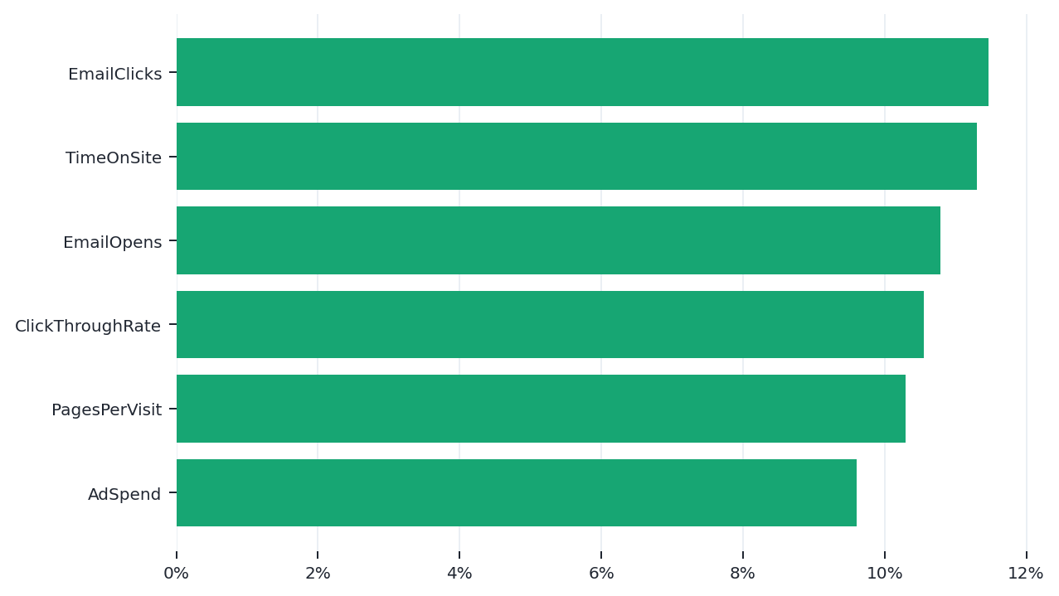
G
GENIE MARKETING | Conversion Intelligence
What Moves Conversion
Conversion Drivers
Key Insight
•
EmailClicks shows the largest lift: high-quartile rows convert about 91.7% vs 80.2% in low-quartile rows.
•
TimeOnSite and EmailOpens also separate stronger from weaker conversion groups.
•
Business meaning: conversion quality is tied more to intent and engagement than to channel alone.
•
Action: improve landing page depth, email click paths, and audience retargeting before scaling spend.
03

Slide 4
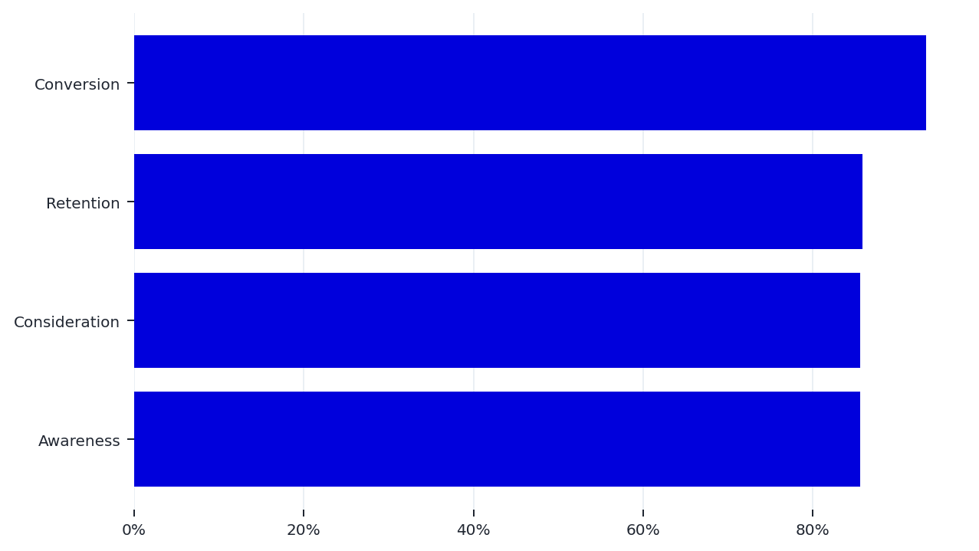
G
GENIE MARKETING | Conversion Intelligence
Where Performance Comes From
Campaign & Channel
Key Insight
•
Conversion campaigns lead with 93.4% observed conversion rate.
•
Programmatic Ads delivers 4,175 conversions, more volume than Social Media.
•
Channel conversion rates are nearly equal, so the channel story is more about volume and cost than conversion quality.
•
Action: manage channel budget using cost per conversion and marginal lift, not conversion volume alone.
04

Slide 5
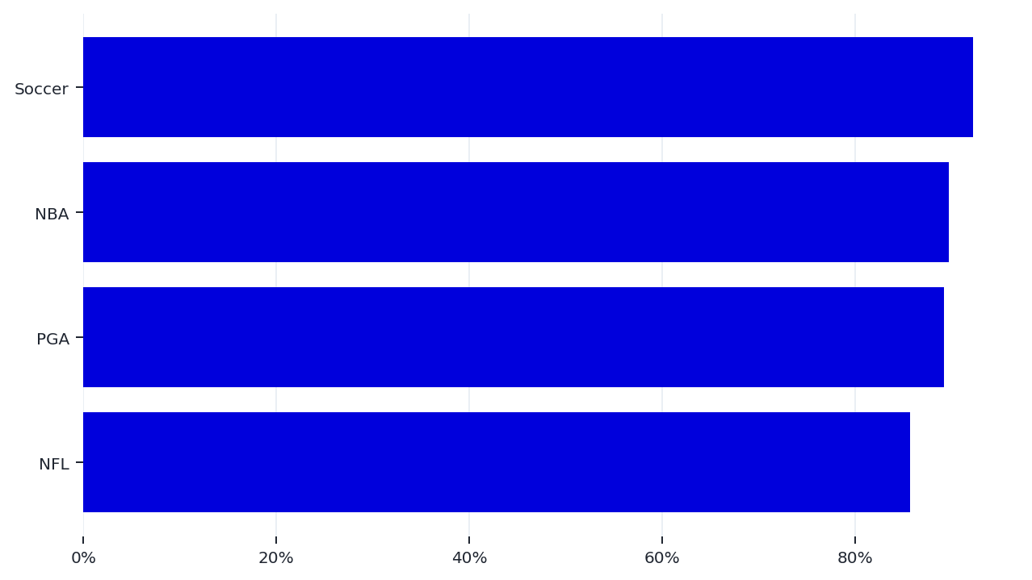
G
GENIE MARKETING | Conversion Intelligence
What Creative Signals Matter
Creative Performance
Key Insight
•
Soccer is the strongest sport segment, while NFL is weakest on observed conversion rate.
•
Top creative combinations mix sport, platform, OS, and size; winners should be scaled as combinations, not isolated labels.
•
Business meaning: creative context matters. A good sport theme can underperform if delivered on weaker platform or OS combinations.
•
Action: build a controlled creative test matrix by Sport x Platform x OS x Resolution.
Top creative examples should be treated as test candidates, not permanent winners, because the dataset does not include date, audience, placement, or frequency.
05

Slide 6
G
GENIE MARKETING | Conversion Intelligence
Intent Signals Are Actionable
Engagement & Customer
Business Meaning
Recommended Actions
•
Time on site and pages per visit should be read as engagement depth, not percentages.
•
Create segments for new, low-history, medium-history, and high-history customers.
•
Previous purchases and loyalty points measure historical relationship; Conversion measures the current campaign outcome.
•
Use email click behavior as an audience for retargeting and offer testing.
•
Returning or loyal customers can still be analyzed for repeat conversion propensity.
•
Improve landing pages where engagement is high but conversion is not increasing.
•
Action: separate new customer acquisition from returning-customer conversion strategy.
•
Track repeat conversion rate separately from first-time conversion rate.
06

Slide 7
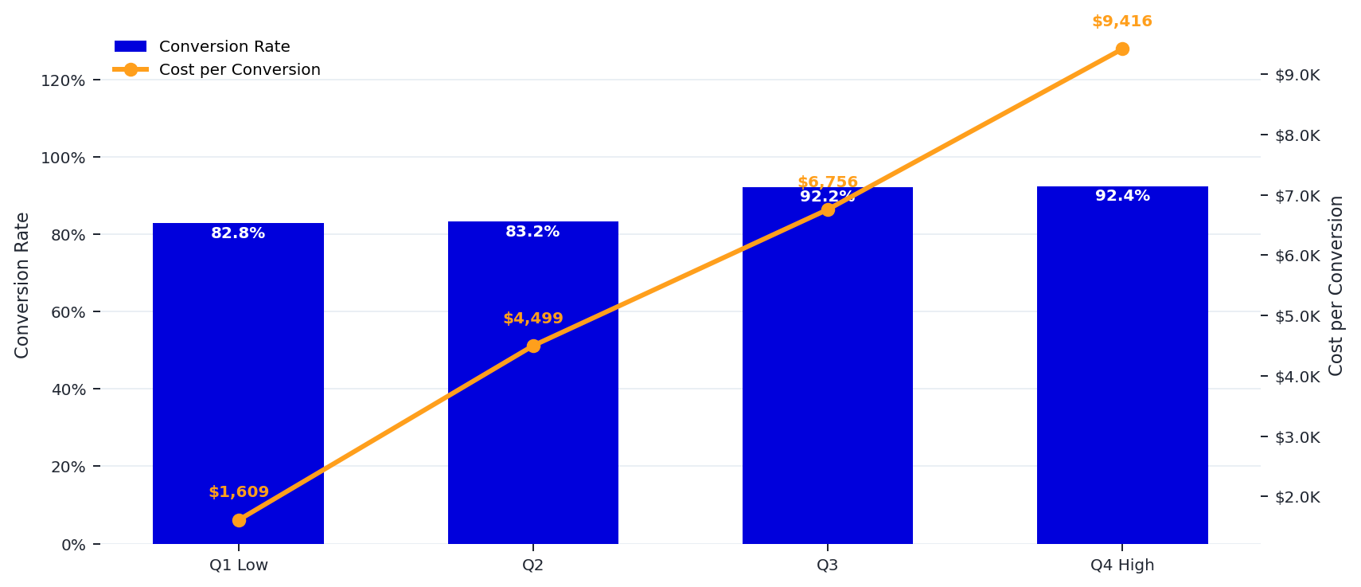
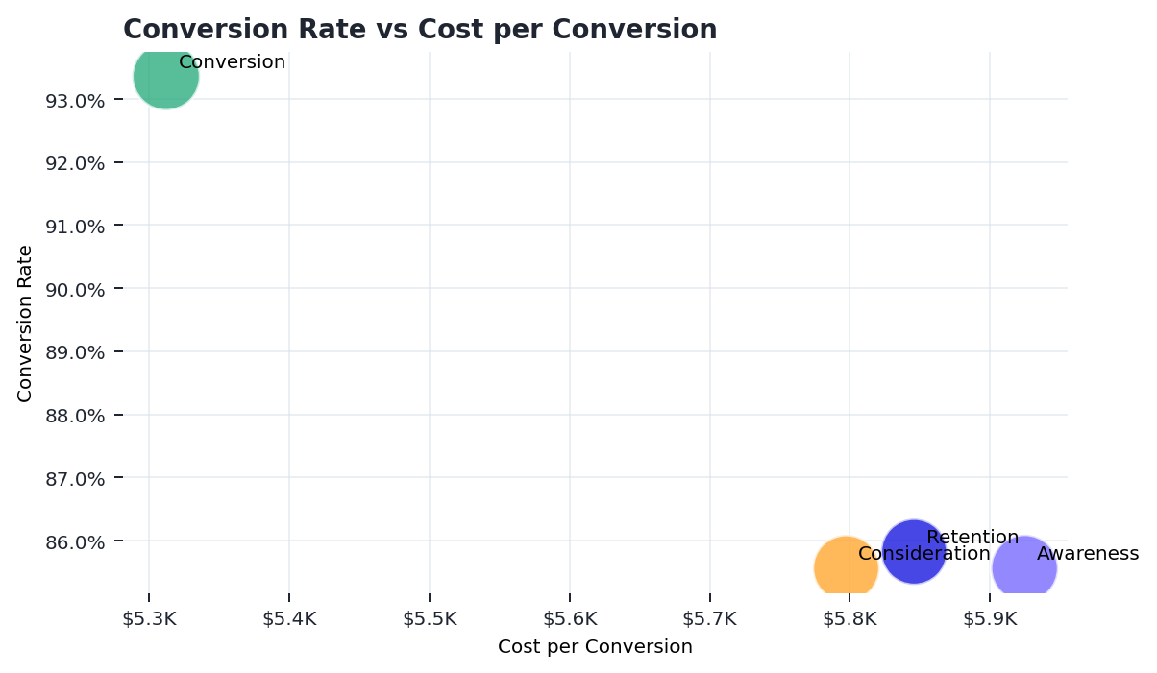
G
GENIE MARKETING | Conversion Intelligence
More Spend Buys Lift, But At A Cost
Spend Efficiency
Key Insight
•
Q1 spend converts at 82.8%; Q4 spend converts at 92.4%.
•
Cost per conversion rises from about $1,609 in Q1 to $9,416 in Q4.
•
Business meaning: higher investment improves conversion rate modestly, but efficiency deteriorates sharply.
•
Action: scale only where incremental conversion lift beats the cost increase.
07

Slide 8
G
GENIE MARKETING | Conversion Intelligence
What To Do Next
Recommendations
1. Optimize Budget
2. Improve Conversion Paths
3. Test Creative Combinations
•
Use cost per conversion guardrails.
•
Prioritize email click journeys.
•
Test sport, platform, OS, and ad size together.
•
Shift budget from high-cost / low-lift segments.
•
Reduce landing page friction.
•
Protect top creatives from overgeneralization.
•
Scale only after marginal lift is visible.
•
Retarget high-engagement visitors.
•
Run A/B tests before budget scaling.
08

Slide 9
G
GENIE MARKETING | Conversion Intelligence
How To Know It Is Working
Success Metrics
Primary KPIs
Diagnostic Metrics
•
Conversion Rate: confirms whether campaign quality improves.
•
CTR: measures ad click appeal.
•
Cost per Conversion: confirms whether growth is efficient.
•
Time on Site and Pages per Visit: measure landing engagement.
•
Total Conversions: confirms business volume.
•
Email Opens and Email Clicks: measure owned-channel intent.
•
Ad Spend: confirms budget discipline.
•
Repeat Conversion Rate: separates returning customer behavior from acquisition.
09

Slide 10
G
GENIE MARKETING | Conversion Intelligence
Data Notes & Assumptions
Methodology
Facts Used
Assumptions
•
Dataset includes campaign, creative, spend, engagement, customer history, and conversion fields.
•
ConversionRate is treated as a pre-calculated campaign metric.
•
CreativeName was enriched into Country, Platform, Operating System, Sport, and Resolution.
•
Because the source denominator is not included, rates are averaged for segment comparison.
•
No missing values were found in the core dataset used for the analysis.
•
Cost per Conversion is calculated as SUM(AdSpend) / SUM(Conversion).
Recommended Data Improvements
•
Validate the official denominator of ConversionRate: visits, clicks, impressions, sessions, or exposed users.
•
Add campaign date fields to measure whether conversion decline is truly happening over time.
•
Track impressions, reach, frequency, placement, audience segment, promotion type, and landing page variant.
10

